Slide 1


AN INTRODUCTION TO OBJECT DETECTION

Slide 2
CONTENTS
What is Object Detection ?
General Steps in Object Detection
Two stage Object detection
What is YOLO?
YOLO vs. other detectors
Working of YOLO
YOLO Versions

Slide 3
KEYWORDS
mAP
(Mean Average Precision)
IoU
(Intersection over Union)
RPN (Region Proposal Network)
Precision and Recall
YOLO
RCNN

Slide 4
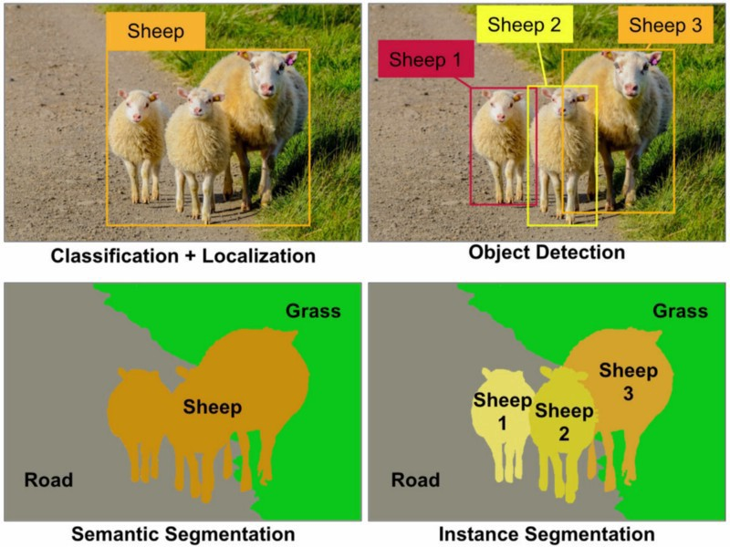
What Is Object Detection?
Notes:
Reference - https://nirmalamurali.medium.com/image-classification-vs-semantic-segmentation-vs-instance-segmentation-625c33a08d50

Slide 5
What Is Object Detection?
Important subdomain of Computer Vision

Slide 6
Steps Involved in Object Detection
Collect and Import the images
Annotation
Dataset Creation
Train the Model (YOLO/RCNN etc)
Deploy the model for Object Detection

Slide 7
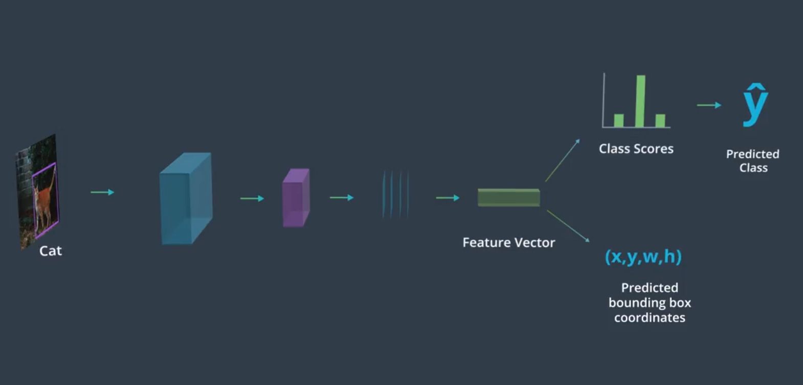
Object Detection - A Naive Approach

Slide 8
Object Detection - A Naive Approach
PROBLEMS???

Slide 9
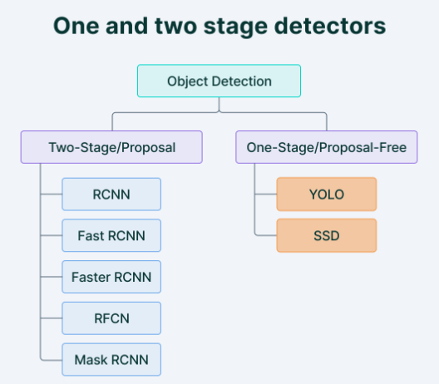
Types of Object Detectors
Reference - https://www.v7labs.com/blog/yolo-object-detection

Slide 10
Two Stage Object Detection
Algorithms break the object detection problem into 2 Steps:
Detecting Possible Object Regions
2. Classifying the image in those regions into object classes
Popular 2 Step Algorithms use Region Proposal Network (RPN) that proposes regions of interest that might contain objects
The RPN output is fed to classifier that classifies the regions into classes.

Slide 11
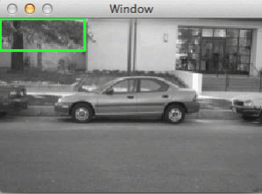
How to get regions in image?
Approach 1 -
Problems
Reference - https://cvexplained.wordpress.com/tag/sliding-windows/

Slide 12
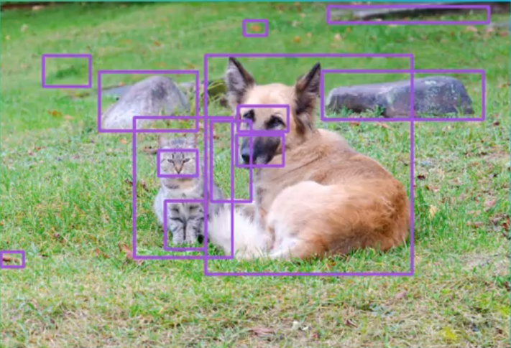
How to get regions in image?
Approach 2 -

Slide 13
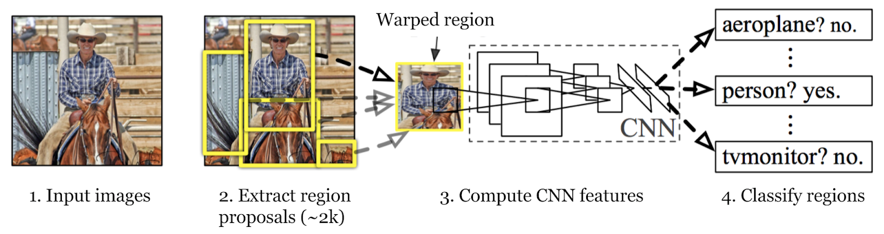
Two Stage Object Detection Using Region Proposal
Reference - https://www.listendata.com/2022/06/region-proposal-network.html

Slide 14
Problems With Two Stage Object Detection??
Disadvantage:
Multiple iterations take place for detection in same image – Detection speed is slow and often not in real time

Slide 15
WHAT IS YOLO ?
You Only Look Once
Reduces the previous two steps into one:

Slide 16
YOLO VS. OTHER DETECTORS
Faster
(> FPS)
Maintains Accuracy in Predictions

Slide 17
WORKING OF YOLO
Step 1: Image is divided into N grids, each with equal dimension – SxS
Each Grid is responsible for detection and localization of object it contains
Step 2: These Grids predict bounding box coordinates relative to their cell coordinates, along with the object label and probability of the object being present in the cell.

Slide 18
OUTCOMES:
Lower Computation as both detection and recognition are handled by cells from the image
Lot of Duplicate Predictions - multiple cells predicting the same object with different bounding box predictions
Non Maximal Suppression used- All bounding boxes with lower probability scores are suppressed

Slide 19
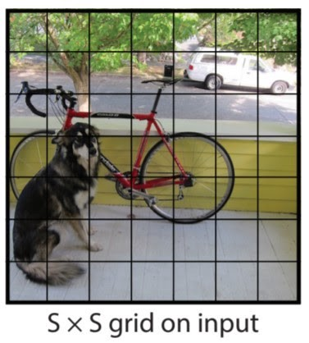
YOLO - Residual Block
Reference - https://medium.com/analytics-vidhya/yolo-explained-5b6f4564f31

Slide 20
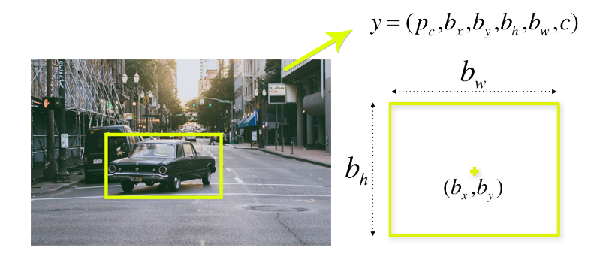
YOLO - Bounding Box Regression
Reference - https://www.section.io/engineering-education/introduction-to-yolo-algorithm-for-object-detection/

Slide 21
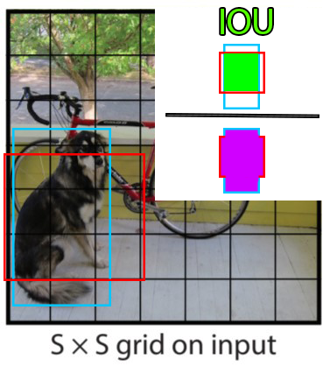
YOLO - Intersection Over Union
Reference - https://www.section.io/engineering-education/introduction-to-yolo-algorithm-for-object-detection/

Slide 22
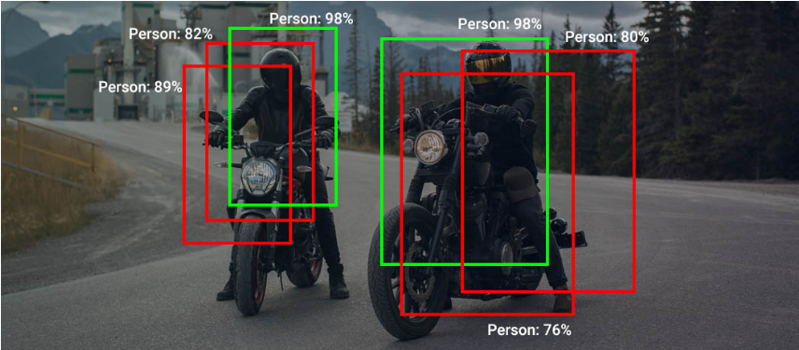
YOLO - Non Maximal Suppression
We select the predictions with the maximum confidence and suppress all the other predictions having overlap with the selected predictions greater than a threshold.
Reference - https://learnopencv.com/non-maximum-suppression-theory-and-implementation-in-pytorch/

Slide 23
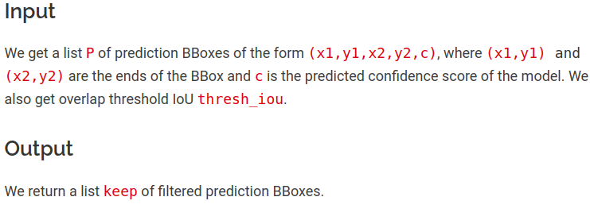
YOLO - Non Maximal Suppression
Reference - https://learnopencv.com/non-maximum-suppression-theory-and-implementation-in-pytorch/

Slide 24
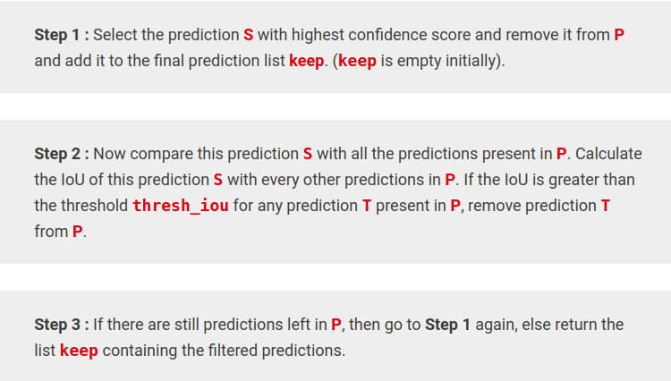
YOLO - Non Maximal Suppression
Reference - https://learnopencv.com/non-maximum-suppression-theory-and-implementation-in-pytorch/

Slide 25
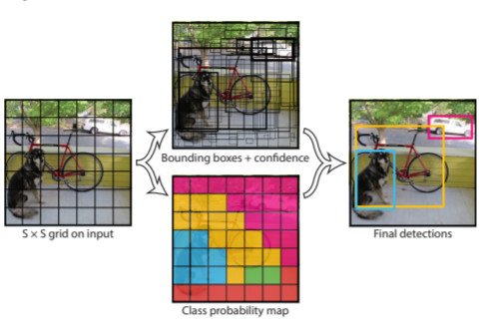
YOLO - Non Maximal Suppression
Reference - https://medium.com/analytics-vidhya/yolo-explained-5b6f4564f31

Slide 26
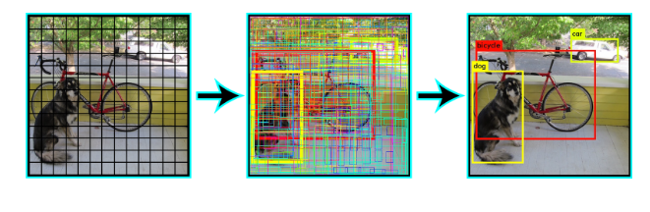
HAVE A LOOK !

Slide 27
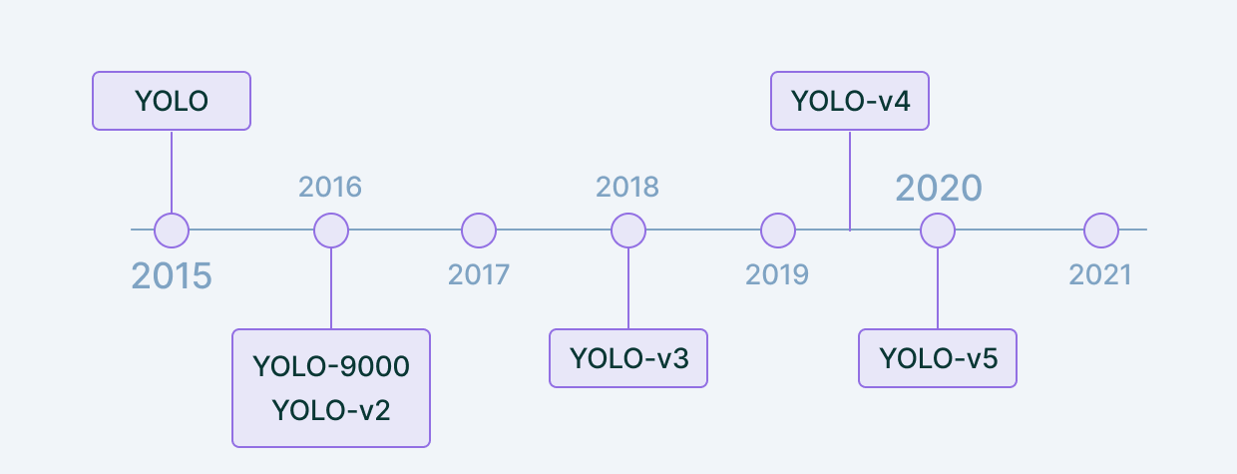
YOLO VERSIONS
Reference - https://www.v7labs.com/blog/yolo-object-detection

Slide 28
THANK YOU…..

